Slide 1
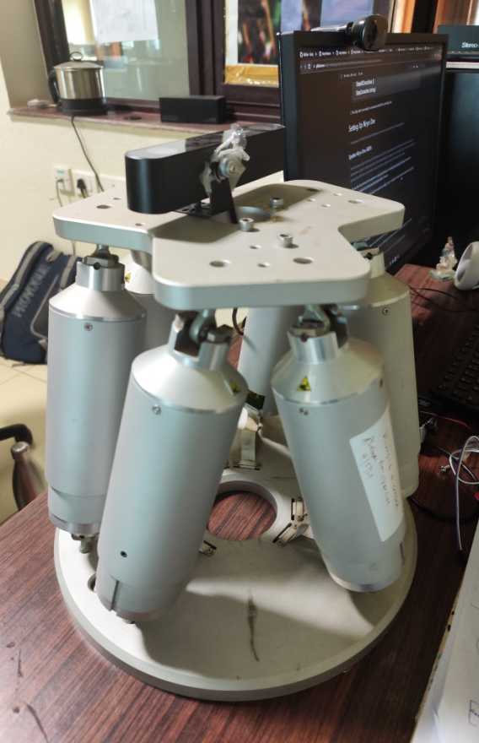
Development of controller for object tracking using the Stewart Platform
Presented by:
Divesh Shet
19ME02008
Project supervisor:
Dr. V. Pandu Ranga
Associate Professor
School of Mechanical Sciences
IIT Bhubaneswar

Slide 2
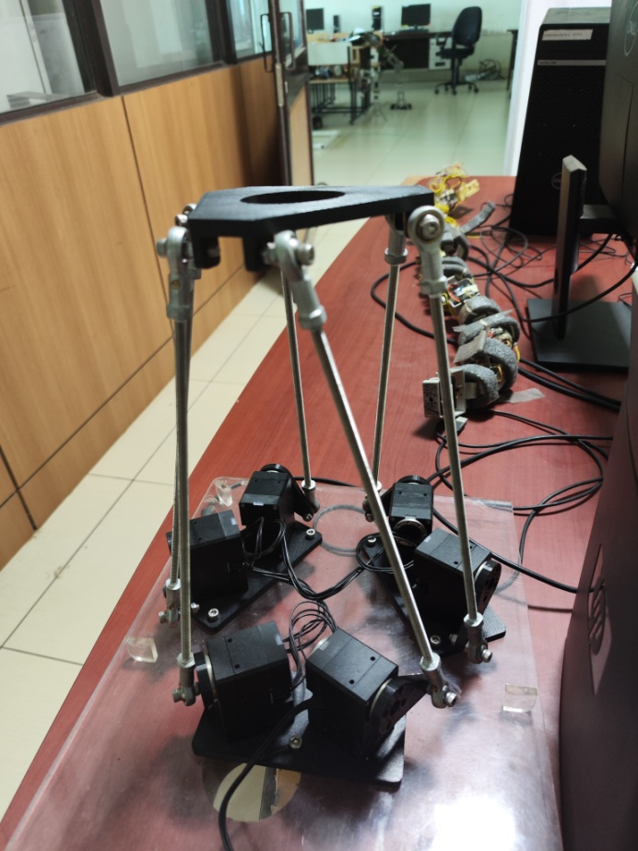
Problem Definition
To develop a controller for 6 DOF RSS Type Stewart Platform to be used to track distant celestial object using camera fixed on top platform.(Large Telescope).

Slide 3
Objectives
A Stewart platform is a type of parallel manipulator that has six actuators.
Our objective is to use Stewart platform in place of gimble to track objects using sensors, which then later could be developed into device capable of tracking celestial bodies by being able to mount heavy objects like heavy radar sensors due to use of Stewart platform, which is more stiff compared to gimble.

Slide 4
Methodology
Deriving Kinematic Equation of location and orientation of COM of the top (movable) platform of the system.
Deriving Dynamic Equations of COM of the Upper platform.
Simulating the results in Matlab.
Developing basic controller for Stewart platform using OpenCM 9.04 and Dynamixel servo motors.
Implementing inverse kinematics model to the basic controller.
Integrating the top platform with Gyroscopic sensor to record orientation of the top platform.
Implementing PID Controller to the system.

Slide 5
Procedure
Inverse kinematics derived
Solve inverse dynamic models- Euler approach
Solve inverse dynamic models- Langrangian approach
Designed assembly in SolidWorks to roughly estimate the workspace
Modelled the system in python to check feasiblity of solutions
Programmed the Microcontroller in Arduino IDE to solve inverse dynamics of system
Developed inverse kinematic controller for Stewart platform (Open loop control system)

Slide 6
Timeline
Task | Timeline
Deriving Inverse Kinematics of COM of Upper platform | 30th September
Deriving Inverse Dynamics of COM of Upper platform | 20th October
Simulating the results of inverse models | 30th October
Developing preliminary Controller using OpenCM 9.04 | 15th January
Implementing inverse kinematics model to the basic controller. | 05th February
Integrating platform with MPU 6050 gyroscope | 10th March
Implementing Sliding mode controller | 01st April
Expected finish date | 20th April
Research about existing Models in parallel.

Slide 7
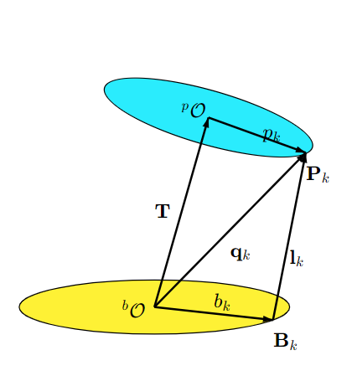
Results
Derived Inverse kinematic equations for:
SPS type Stewart Platform in 3D.
l_{k}​ = P_{k}​ − B_{k} ​= T + R × p × R −b_{k}​
For a Stewart Platform with linear actuators this is all that is needed. The length |l_{k}​∣ can be used as the input for the controller.^{[7]}

Slide 8
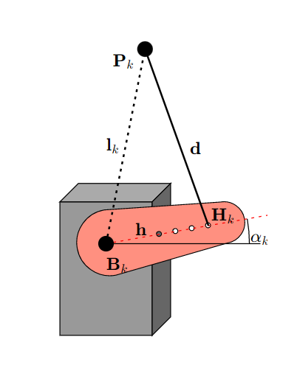
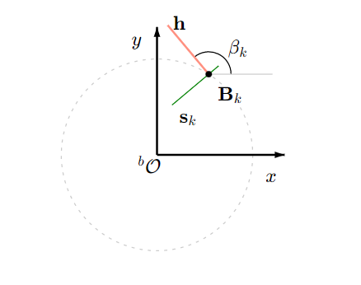

Results
Derived Inverse kinematic equations for:
RSS type 3D Stewart Platform.

Slide 9
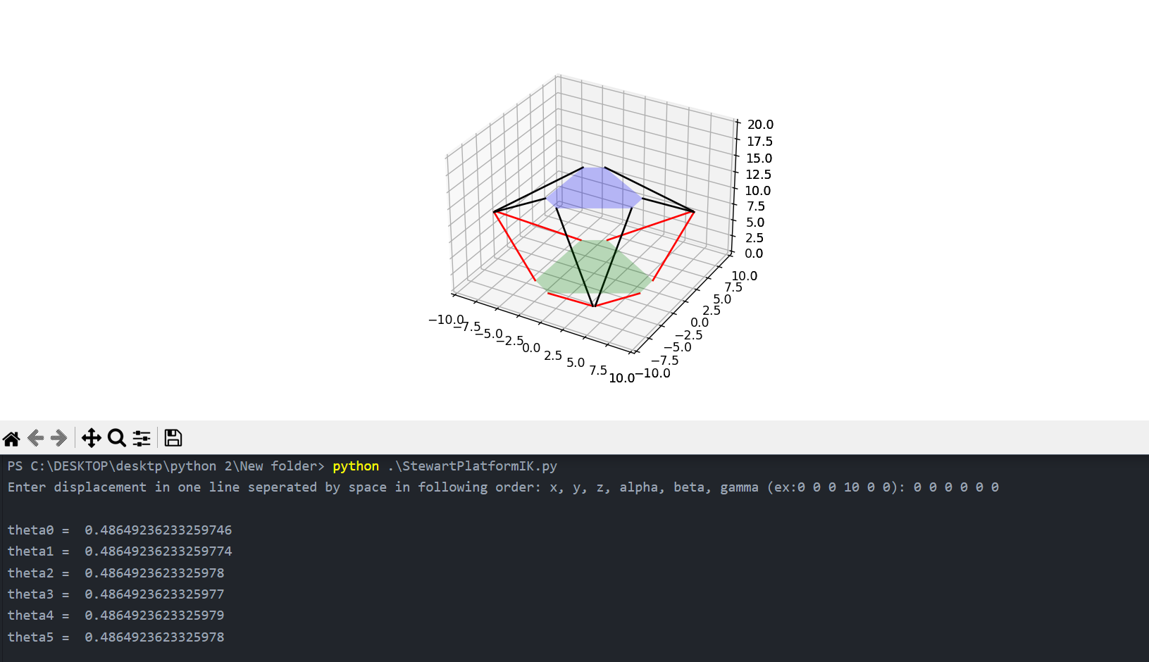
Results
Python program for simulating inverse kinematic model

Slide 10
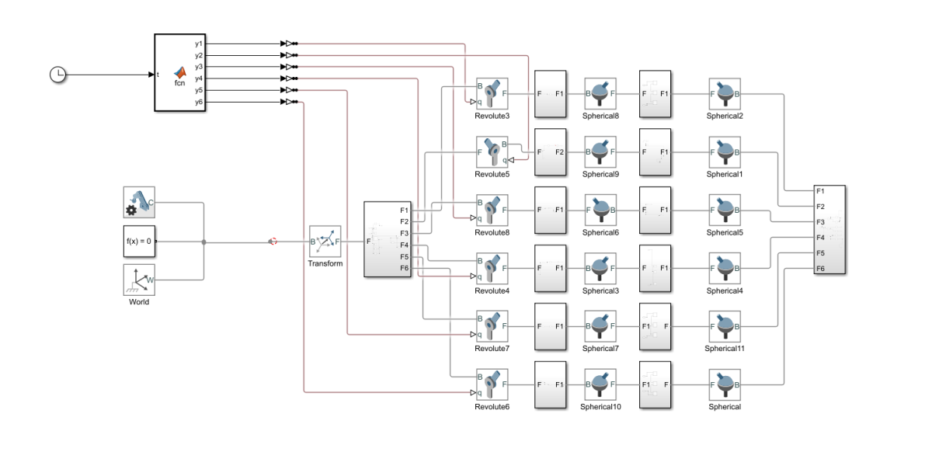
Results
Simulink model for 6 DoF RSS type Stewart platform

Slide 11
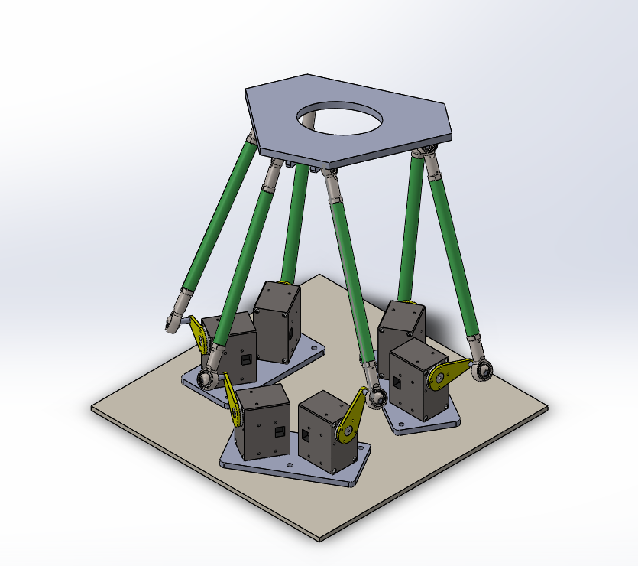
Results
SolidWorks Assembly of 6 DoF RSS type Stewart platform

Slide 12
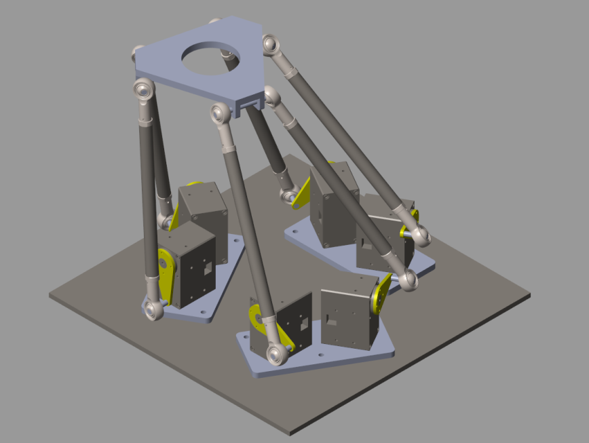
Results
Motion study of Stewart platform in SimScape Mechanics Explorer

Slide 13
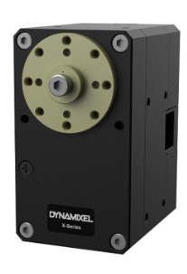
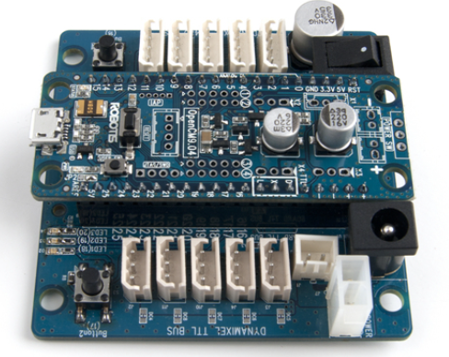
Hardware Description
Dynamixel XM540-W270-R Servo motor
OpenCM 9.04 Micro-controller

Slide 14
Steps taken
Learning to use new components: OpenCM 9.04 and Dynamixel servo motors
Organized documentation of basic controller code
Implementation of Inverse Kinematic model
Modeling the Stewart platform in Arduino for implementing inverse kinematics and setting limits to the servo arm angle
Giving appropriate input to the motors.
Aligning coordinate system of model and the physical system
Redesigning the top platform
Getting Feedback of orientation of output using MPU6050 mounted on top platform.

Slide 15
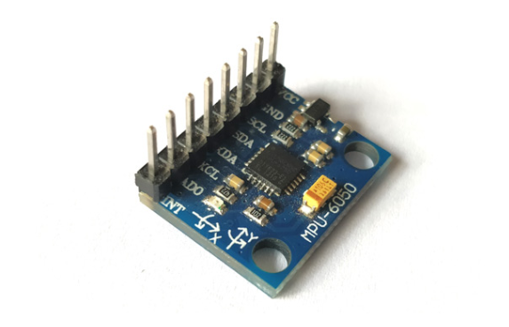
Difficulties faced
Integrating the system with gyroscope for optimizing the accuracy of the system

Slide 16
4 Approaches explored
MPU-> OpenCM9.04 Expansion Board-> OpenCM 9.04
MPU->Arduino Mega->OpenCM 9.04
MPU->Arduino Mega->ROS->OpenCM 9.04
MPU->OpenCM 9.04

Slide 17
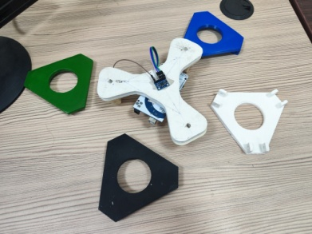
Other miscellaneous studies
New design for top platform was developed for economical reasons.
Multiple platforms had to be 3d printed during testing of the inverse model.
Updates in model and programs to account for change in top platform designs.
Platform position was measured using gyroscope.
(to calculate error in system).

Slide 18

Stewart Platform in Motion
Link to video: https://drive.google.com/file/d/1WmIhB8NkMlCb7K1bPzzJTsA-tyP6Nh5m/view?usp=sharing

Slide 19
References
https://ieeexplore.ieee.org/abstract/document/222651
https://link.springer.com/article/10.1007/BF01257946
https://onlinelibrary.wiley.com/doi/abs/10.1002/rob.4620100506
https://www.tandfonline.com/doi/full/10.1080/13873954.2020.1754861

Slide 20
Soft Skills:
Effective Communication: Clear and concise communication in both verbal and written forms.
Collaboration and Teamwork: A strong collaborative spirit with seamless teamwork.
Adaptability and Flexibility: Remarkable adaptability to unexpected challenges.
Leadership and Initiative: Demonstrated leadership and proactive decision-making.
Time Management: Consistent adherence to deadlines with efficient resource allocation.
Independent Work: Strong ability to work independently with self-motivation.
Root Cause Analysis: Proactive approach to understanding and solving underlying issues.
Innovative Thinking: Creative and innovative problem-solving in complex situations.

Slide 21
Thank you

